Slide 1
Fight against 2019-Novel Coronavirus Disease
Prof. Dr. Muhammad Akram Munir
BSc AH, BVSc (Pb) MSC Hons (UAF),
MSc (USA) PhD (USA), Postdoc (Micro)
Best HEC teacher; IZAZ-E-KAMAL
Riphah International University, RCVetS, Raiwind Road, Lahore
akrammuneer@hotmail .com
VU Webinar 26-8-2020

Slide 2
Coronavirus Virion Structure
Spike glycoprotein
Membrane glycoprotein
Envelop
Small envelop glycoprotein
Nucleocapsid Phosphoprotein

Slide 3
7 types of Human Coronaviruses (CoVs)
HKU1 (2005) originated from infected mice
NL63 (2004) originated from a 7 months old baby
OC43 (2000-2001)recovered from children/adults can infect cattle
229 E (1965) identified in Chicago from a common cold virus
SARS-CoV (2003) an animal reservoir; from bats to civet cats to humans
MERS CoV (2012) identified from Saudi Arabia, possibly originated from bats and infected Dromedary camels which are major reservoir
SARS-CoV-2 (nCoV-19) December 2019, Novel coronavirus 19, Wuhan coronavirus, Wuhan seafood market pneumovirus

Slide 4
Coronaviruses
Cause diseases in both humans and animals; mainly affect the
Respiratory system
Digestive system
Nervous system
Reproductive system
Urinary System
Some heart problems

Slide 5
Pandemic level
ALREADY INFECTED OVER 213 COUNTRIES
Reported cases worldwide 23, 789,954 (As of August 24)

Slide 6
CoVID 19 infection IN PAKISTAN As of 24th August
Infected 293,261 cases
Deaths 6,244
Recovered 276,829
Critical/serious 771
Situation in neighboring Countries (deaths/total cases)
India 58546/3164881
Afghanistan 1389/38054
Iran 20776/361150
China 4634/84967

Slide 7
Countries with deaths < 25:
Epidemiologists need to investigate the reasons of low prevalence in following countries.
Rawanda, Maldives, Sri Lanka, Mozabique,Iceland, Newzealand, Uganda, Jordan, Cyprus, Georgia, Bahamas, Malta, Botswana, Jamaica, Aruba, Vietnam, Lesotho, Sao Tome and principe, Reunion, Diamond Prince, Guyana, Tanzania, Burundi, Taiwan, Mauritius, Papua new Guinae, (and many others)

Slide 8
SARS-CoV-2: Important Characteristics
Bats could be original source of SARS-CoV-2
96 % sequence homology to bats CoV and 80 % identical to SARS virus
Displays frequency of mutation
Difficult to grow in cell culture
Generally have tropism for respiratory and intestinal epithelium but can also infect other systems
Asymptomatic infection (without clinical signs) carriers (One case infected 5 people without showing clinical signs).
No pre-existing immunity to SARS-CoV-2; vaccines being developed
Only poorly effective antiviral drugs available

Slide 9
Effects of COVID-19 on normal life
Routine life activities are being halted
Social distancing from masses
School, colleges, training centers, cinemas, theatres etc. closed
Congregations at churches and mosques, sports, wedding ceremonies, Pakistan Independence/ March 23 parades, air flights etc., suspended.
Stock markets are down/crashed
Global economic problems, all types of trade and oil prices negatively affected; drastic rehabilitation measures needed
National and international emergencies
WHO declared it - global health emergency on January 30, 2020,and pandemic on March 11th, 2020

Slide 10
Transmission
Initially many patients in covid-19 outbreak in Wuhan had some link to seafood and live animal markets suggesting animal-to-person spread
Eating of snakes and bats helped in picking of infection, other animal source also possible
Now from person-to-person; through respiratory droplets amongst close-contacts, community spread, airborne spread over short distances also possible
Transmission via infected hands, saliva, fecal material, and urine and contaminated surfaces

Slide 11
Animal CoVs
Several CoV infect various animal species but not yet infected humans e.g.
Feline Infect. Peritonitis/enteritis, diarrhea
AIB chicken/ Turkey CoV
Canine CoVs -2 types
Bovine CoVs
Swine CoVs - 3 types
Rabbit coronavirus; diarrhea
Mouse COV
Mink CoVs
Bat (About 5000 CoVs present in bats)
Snake CoVs

Slide 12
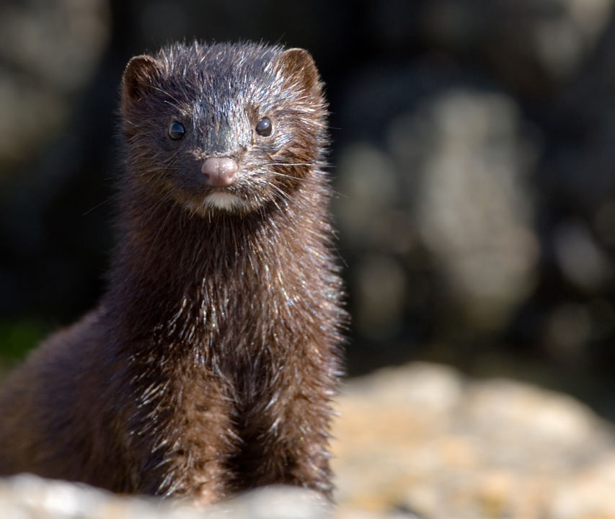
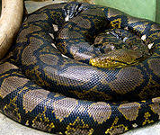
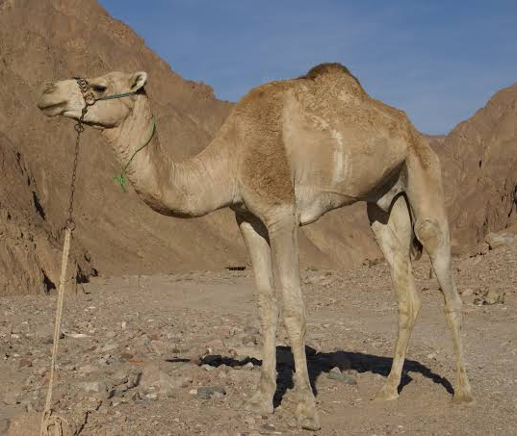
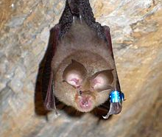
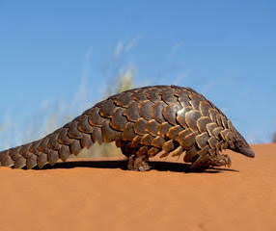
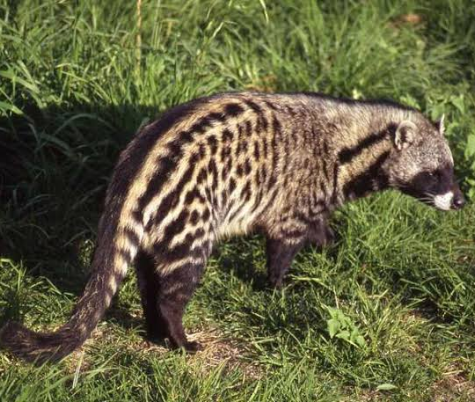
Mink
Reticulated Python
Dromedary Camel
Horseshoe Bat
Pangolin
African Civet

Slide 13
Susceptibility/survival of Virus
Temperature above 30ºC
Chemicals ( 60-70% Alcohol, H₂O₂, 0.1% sodium hypochlorite, etc)
Alcohol based hand Sanitizer
Virus survival: 48 hours on surfaces; 9 days in environment ; 96 hrs in sputum, serum or feces; 5 days in respiratory specimen
5. Stable at pH 6-6.5

Slide 14
Drug Name | Mechanism of Action | Side Effects
1.Hydroxychloroquine (Antimalarial drug) | Increases the endosomal pH, inhibiting fusion of the virus and the host cell membranes Not proved effective in clinical trials | Nausea, vomiting, diarrhea Hepatitis Hypoglycemia
2. Chloroquine (Antimalarial Drug) | Increases endosomal pH, inhibiting fusion of SARS-CoV-2 and the host cell membranes Inhibits glycosylation of the cellular receptor, which may interfere with binding of the virus to the cell receptor | Ventricular arrhythmia Nausea, vomiting, diarrhea) Hepatitis
3. Azithromycin AZM with HCQ (Hudroxychloroquine) | Induction of IFN-stimulated genes, attenuating viral replication Enhanced neutrophil activation | Gastrointestinal effects (e.g., diarrhea, nausea, vomiting) Hepatotoxicity

Slide 15
Drug Name | Mechanism of Action | Side Effects
2. HIV Protease Inhibitors 3.Darunavir (DRV) 4. Lopinavir (LPV) 5. INF Beta (Antiviral Drugs) | Inhibition of viral protease enzyme resulting in non-functional proteins | Gastrointestinal effects (e.g., nausea, vomiting, diarrhea)
6.Remdesivir (Antiviral Drug) | Binds to viral RNA-dependent RNA polymerase, inhibiting viral replication through premature termination of RNA transcription | Transient elevations in alanine transaminase or aspartate transaminase levels Renal toxicity Gastrointestinal symptoms (e.g., nausea, vomiting)
7. Dexamethasone (Corticosteroid) | dampening down the body's immune system. | fluid retention, weight gain, high blood pressure, headache,

Slide 16
HERD IMMUNITY

Slide 17
Herd Immunity is a form of indirect protection from infectious disease that occurs when a sufficient percentage (about 65 to 70%) of a population has become immune to an infection whether through vaccination or previous infections, thereby reducing the likelihood of infection for individuals who lack immunity

Slide 18
VACCINE TYPES
Live Vaccines
Live Attenuated Vector Vaccines
Chimeric Vaccines
DNA Vaccines
Inactivated/Killed Vaccines
Protein vaccines
Recombinant subunit vaccines
mRNA vaccine for SARS-CoV-2 being developed in USA (Phase III clinical trial)
Adjuvants added vaccines

Slide 19
SARS-CoV-2 Vaccine Development; May not be available to help in control of present pandemic
Presently no vaccine; several international groups working on developing vaccine
China-Pakistan collaboration underway, testing phase
Russia has developed a vaccine (being evaluated)
Virus Spike protein (S1 or both S1 and S2) molecules might be good candidates
Highly mutagenic nature may require extensive work at molecular level (different antigenic variants possible)
Must have good efficacy, immunogenicity & safety

Slide 20
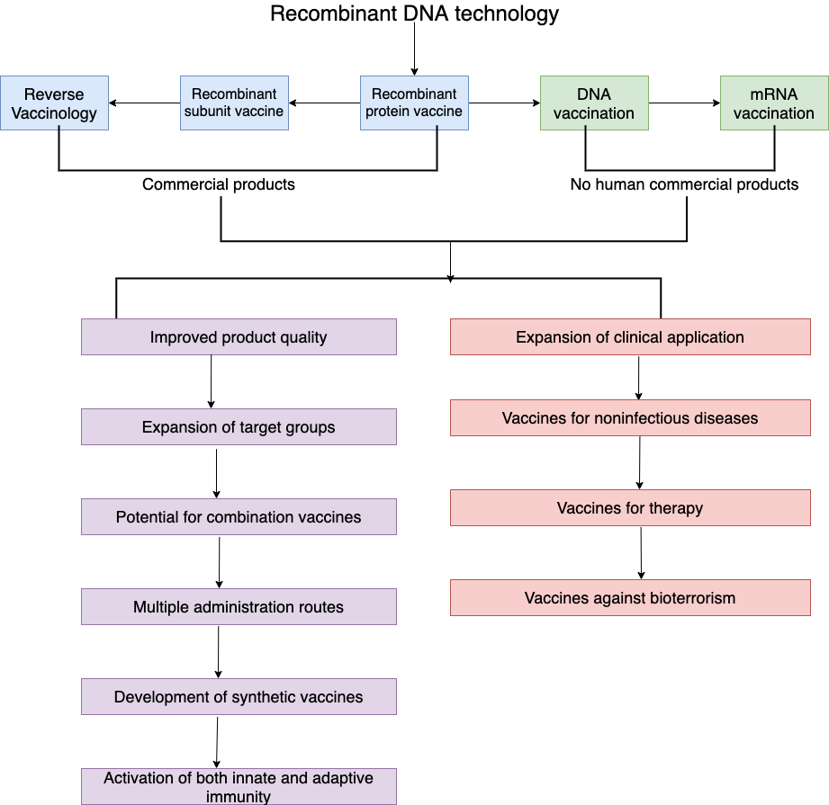

Slide 21
CORONAVIRUS VACCINE TRACKER CVT
Globally over 165 Research groups are trying to develop vaccines
32 vaccine types are in trials in humans
135+ vaccines in preclinical trial
21 vaccines testing safety and dosage (phase 1)
13 vaccines in expanded safety trials (phase 2)
8 vaccines in large-scale efficacy tests (phase 3)
2 approved for limited use

Slide 22
CVT
Moderna in partnership with National Institutes of Health (Phase 3)
German company BioNtech entered into collaborations with Pfizer and Fosun Pharma (Phase 3)
Zydas Cadila Indian vaccine maker (Phase 2)
CureVac German company (Phase 2)
Imperial College London with Morningside Ventures (Phase ½)
Takara Bio Japanese company with Osaka University (Phase 1)

Slide 23
CVT
Arcturus California-based (Phase 1 / 2)
Inovio American company (Phase 1)
Genexine Korean company (Phase 1)
Abogen Biosciences Chinese (Phase 1)
Sanofi French company (Preclinical)
CanSinoBIO Chinese company (Phase 3, approved for limited use)
AstraZeneec British-Swedish company (Phase 3)

Slide 24
Diagnostic tests
Reverse transcription polymerase chain reaction (RT-PCR)
Rapid diagnostic test (RDT)
Enzyme-linked immunosorbent assay (ELISA)
Neutralization assay
Chemiluminescent immunoassay
Haemagglutination test????

Slide 25
PLASMA THERAPY
Recovered patients from COVID-19 develop antibodies to SARS-CoV-2
Plasma is collected from donors who have recovered from COVID-19 through a process called apheresis
The rest of the blood components are returned into the donor’s body
The collected convalescent plasma is then transfused to patients
https://jamanetwork.com/journals/jama/fullarticle/2767351

Slide 26
Potential Risks of Convalescent Plasma
Mild allergic reaction
Transfusion-associated circulatory overload
Transfusion-associated acute lung injury
Infections
As with all blood products, convalescent plasma must be thoroughly tested before use
SARS-CoV-2 is not spread by blood, and there is no risk of transmission from recovered donors

Slide 27
CoVID Myths vs Reality
Are hand dryers effective in killing the virus NO
Can UV lamp kill the virus NO
How effective are thermal scanners in detecting coronavirus infected person (EFFECTIVE)
Can spraying alcohol or chlorine kill the virus (NO)
Is it safe to receive a packet from CoVID-19 infected country (YES)
Can pets at home spread the virus (NO Evidence) but infected people may transmit to certain pets
Are vaccines against ordinary pneumonia protective against CoVID-19 (NO)
Can gargling with mouth wash protect from this virus (NO)

Slide 28
CoVID-19 myths vs reality
Can eating garlic prevent CoV infection (NO)
Can putting on sesame oil block the virus from entering host body (NO)
Does this virus infect the older and young people (PEOPLE OF ALL AGES ARE INFECTED)
Are antibiotics effective against this disease (NO)
Are there any antivirals effective (SO FAR NONE)

Slide 29
Precautionary & control measures
1. Regularly and thoroughly clean your hands with an alcohol-based hand rub or wash them with soap and water. Both the procedures kill viruses that may be on your hands.
•2. Maintain at least 2-meter distance between yourself and others. Why? When someone coughs, sneezes, or speaks they spray small liquid droplets from their nose or mouth which may contain virus.
(If you are too close, you can breathe in the droplets, including the COVID-19 virus if the person has the infection or disease).
•

Slide 30
Precautionary & control measures
•3. Avoid going to crowded places. Why? Where people come together in crowds, you are more likely to come into close contact with someone who has COIVD-19 and it is more difficult to maintain 2-meter distance .

Slide 31
Precautionary & control measures
•4. Avoid touching eyes, nose and mouth. Why? Hands touch many surfaces and can pick up viruses. Once contaminated, hands can transfer the virus to your eyes, nose or mouth. From there, the virus can enter your body and infect you.

Slide 32
Precautionary & control measures
5. Make sure you, and the people around you, follow good respiratory hygiene. This means covering your mouth and nose with your bent elbow or tissue when you cough or sneeze. Then dispose of the used tissue immediately and wash your hands. Why? Droplets spread virus. By following good respiratory hygiene, you protect the people around you from viruses such as cold, flu and COVID-19.

Slide 33
Precautionary& control measures
•6. Stay home and self-isolate even with minor symptoms such as cough, headache, mild fever, until you recover. Have someone bring you supplies. If you need to leave your house, wear a mask to avoid infecting others. Why? Avoiding contact with others will protect them from possible COVID-19 and other viruses.

Slide 34
Precautionary & control measures
7. If you have a fever, cough and difficulty breathing, seek medical attention, but call by telephone in advance if possible and follow the directions of your local health authority. Why? National and local authorities will have the most up to date information on the situation in your area. Calling in advance will allow your health care provider to quickly direct you to the right health facility. This will also protect you and help prevent spread of this virus and other infections.

Slide 35
Precautionary & control measures
8. Keep up to date on the latest information from trusted sources, such as WHO or your local and national health authorities. Why? Local and national authorities are best sources to advise on what people in your area should be doing to protect themselves.

Slide 36
Precautionary & control measures
How to use alcohol-based hand sanitizers
9. To protect yourself and others against COVID-19 virus, clean your hands frequently and thoroughly. Use alcohol-based hand sanitizer or wash your hands with soap and water. If you use an alcohol-based hand sanitizer, make sure you use and store it carefully.

Slide 37
Precautionary & control measures
10. Keep alcohol-based hand sanitizers out of children’s reach. Teach them how to apply the sanitizer and monitor its use.
11. Apply a coin-sized amount on your hands. There is no need to use a large amount of the product.
12. Avoid touching your eyes, mouth and nose immediately after using an alcohol-based hand sanitizer, as it can cause irritation.

Slide 38
Precautionary & control measures
13. Hand sanitizers recommended to protect against COVID-19 virus are alcohol-based and therefore can be flammable. Do not use before handling fire or cooking.
14. Under no circumstance, drink or let children swallow an alcohol-based hand sanitizer. It can be toxic.
15. Remember that washing your hands with soap and water is also effective against COVID-19 virus.

Slide 39
Role of international organizations
There is immense need for cooperation at national and international levels especially the OIE , WHO , FAO and financial organizations like Asian Bank, World Bank, IMF, etc
Developing nations need stronger help in dealing with COVID-19. It is a zoonotic disease requiring coordination/cooperation of WHO, OIE and FAO) under One-Health Program
﻿

Slide 40
Way Forward
In Pakistan, progressive decrease of cases and deaths but disease still exists
Awareness campaign of public through print and visual media (well taken care) be continued
OIE, WHO, FAO, and other donor agencies need to establish a pool of scientists, network of viable laboratories for scientific advances on highly pathogenic emerging and re-emerging diseases
Need for provision of financial help to poor and developing nations on research on CoVs, pandemic handling, rehabilitation etc.

Slide 41
MESSAGE FROM THE PRESENTATION
This problem may exist for a longer duration
Eat healthy and fully cooked food
Practice biosafety and biosecurity, wear mask
Avoid visiting live animal and sea food markets
Practice personal hygiene, social distancing
Avoid visiting hospitals without proper wear
Wash hands frequently especially after touching the sick persons
Although cases in India, Iran, Afghanistan, China and Pakistan are on rise let us be aware on preventive measures than being Panicky

Slide 42
OUR PLEDGE
“This outbreak is a test of solidarity -- political, financial and scientific personnel. We will be together to fight a common enemy that does not respect borders, race or religion. We ensure that we have the resources necessary to bring this outbreak to an end”

