Slide 1
Genomic technologies for development of therapies against COVID 19.
Dr. Zahid Hussain
Associate Professor of Biotechnology
Government College University Lahore
Pakistan

Slide 2
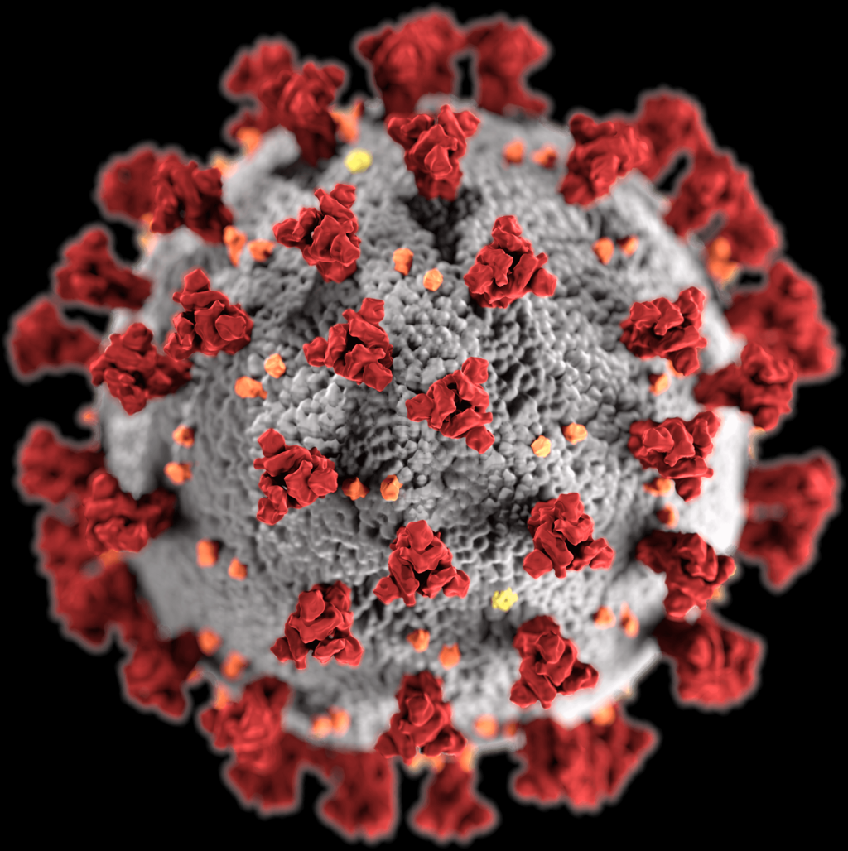
COVID-19 Genome
Coronaviruses contain a positive-sense, single-stranded RNA genome.
The genome size for coronaviruses ranges from 26.4 to 31.7 kilobases.
The genome size is one of the largest among RNA viruses.
The genome has a 5′ methylated cap
and a 3′ polyadenylated tail.

Slide 3
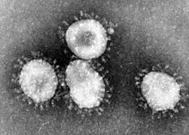
The later reading frames encode the four major structural proteins: spike, envelope, membrane, and nucleocapsid.
Interspersed between these reading frames are the reading frames for the accessory proteins.
The number of accessory proteins and their function is unique depending on the specific coronavirus.

Slide 4
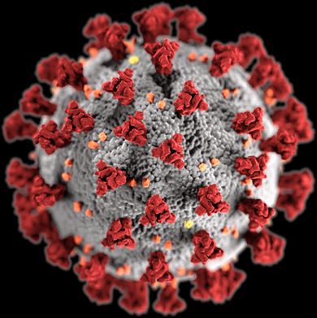
The coronavirus surface spikes are homotrimers
of the S protein, which is composed of an S1 and S2 subunit.
The homotrimeric S protein is a class I fusion protein
which mediates the receptor binding and membrane fusion
between the virus and host cell.
The S1 subunit forms the head of the spike and has the
receptor binding domain (RBD).
The S2 subunit forms the stem which anchors the spike in the viral envelope and on protease activation enables fusion. The E and M protein are important in forming the viral envelope and maintaining its structural shape.

Slide 5
Infection begins when the viral spike protein attaches to its complementary host cell receptor.
After attachment, a protease of the host cell cleaves and activates the receptor-attached spike protein.
Depending on the host cell protease available, cleavage and activation allows the virus to enter the host cell by endocytosis or direct fusion of the viral envelop with the host membrane.

Slide 6
WGS can help to understand transmission of COVID 19
Understanding changes in the genetic sequence of the viral genomes collected from different patients allows researchers to build a viral ‘family tree’ and contribute to efforts to monitor disease spread within and between populations over time.
This can help with identification of infection ‘hot spots’, or of super spreaders – individuals who transmit the infection to a larger than expected number of people.
This information is valuable for planning targeted public health interventions to reduce disease spread.

Slide 7
To monitor virus evolution
Continually tracking the virus will alert researchers to genetic changes that might give rise to less virulent or more virulent strains.
Less virulent strains can be used as attenuated vaccine against COVID-19.
This can help us in effective control of COVID-19 infection.

Slide 8
Receptor binding protein blockage
It is possible to design proteins that can bind to receptor binding protein
Block the entry of virus in host cell
Thus will stop replication of virus

Slide 9
Sequencing can help in detection
The Real Time-RT PCR can help in detection of covid-19.
We can design primers on the basis of WGS and can develop detection kits for COVID-19.
These detection kits can help in detection and thus effective control of COVID-19 spread in the population.
More effective testing facility can help in more effective control

Slide 10
To design treatments and vaccines
Understanding the viral DNA sequence will assist researchers designing therapies and vaccines that target specific features of the virus.
It will also allow better understanding of how therapy and vaccine effectiveness might change as the virus evolves.
This knowledge will help us in designing more effective vaccines

Slide 11
Genome Editing
Through studies we can know about proteins responsible for pathogenesis.
Sequencing can help in identification of nucleotide sequence of that specific gene of that particular protein
The gene coding for that specific protein can be knocked out with help of genome editing technology
And the COVID-19 strain can be used to induce humoral and cytotoxic immune response

Slide 12
Expression in E.coli (Non pathogenic strain)
The gene of spike protein can be cloned and overexpressed in Escherichia coli (BL21 strain).
The expression of this protein will be coupled with Listeriolysin O protein gene.
The spike protein will activate humoral response
Listeriolysin O will help in the entry of bacterial cells in antigen presenting cells and the activation of cell mediated immunity.
CD8 T cells activation is essential for the lasting adaptive immunity.

Slide 13
Expression in vaccinia virus
Vaccinia virus can serve as a vector and can carry S spike protein gene in the host cell
Can help in T cells activation
It help in building more effective and long lasting immunity against COVID-19.

Slide 14
Dendritic cell vaccine

Slide 15
mRNA as a vaccine
mRNA of COVID-19 can be designed to express COVID-19 protein.
This protein can help in induction of T cell immunity.
T cell dependent antigen can help in production of permanent immunity against COVID-19.

Slide 16
Designing of Replicase/protease inhibitors
Through sequencing we can know sequence of Replicase/protease gene
We can clone and over express Replicase/protease gene
The Replicase/protease protein will be purified and 3D structure determined through protein crystallography
Through docking studies inhibitors can be screened out.
The short listed potential inhibitors of Replicase/protease enzyme can be synthesized and evaluated for their potential in control of COVID-19 proliferation

